Slide 1

Data Warehouses
Lecture # 3
Topic : NoSQL and Selected Topics For Data Warehousing
Prepared by: Basem Khalaf
Semster-1 , Level-3
Fall 2023

Slide 2
Agenda
NoSQL Databases & Data Warehouses
Data Warehouse Governance and Backup Strategies
Data Cleaning and Transformation in Data Warehousing

Slide 3
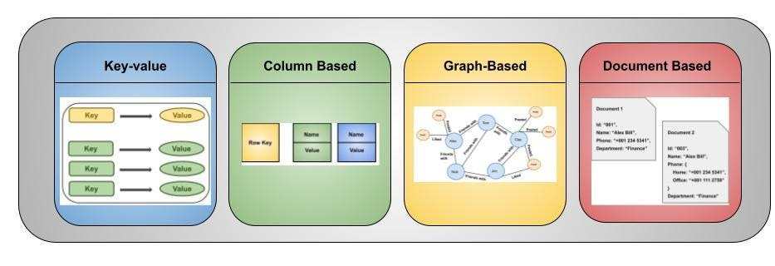
NoSQL Databases
Definition:
NoSQL databases are non-relational databases designed for scalability, flexibility, and performance in handling large and diverse data sets.
DynamoDB
Apache Cassandra
Neo4j
MongoDB
Scalable, Flexible, High-Performance

Slide 4
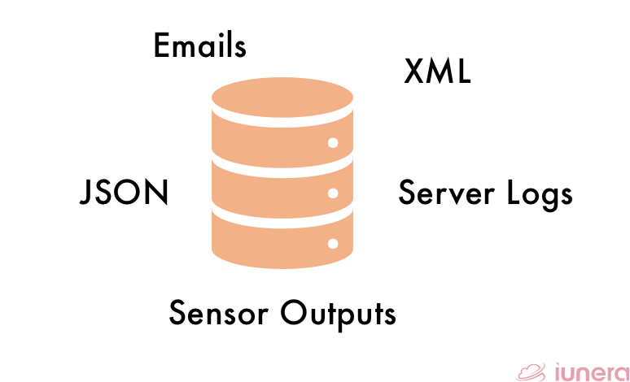
Why NoSQL Databases ?
Traditional Limitations:
Relational databases struggle with high data velocity and unstructured formats.
Scaling is costly and complex.
NoSQL Strengths:
Schema Flexibility: Supports unstructured, semi-structured, and structured data.
Horizontal Scalability: Easily scales across distributed systems.
Speed: Optimized for large-scale, high-speed read/write operations.
Diversity: Various models (e.g., Key-Value, Document) fit specific use cases.

Slide 5
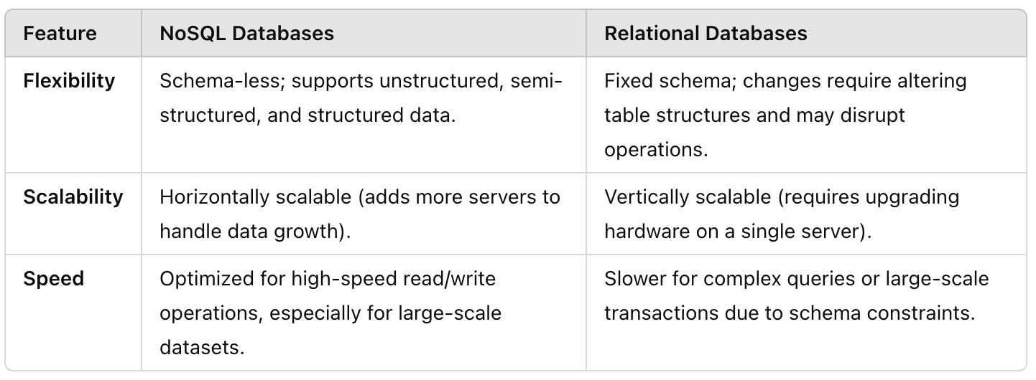
Why NoSQL Databases ?

Slide 6
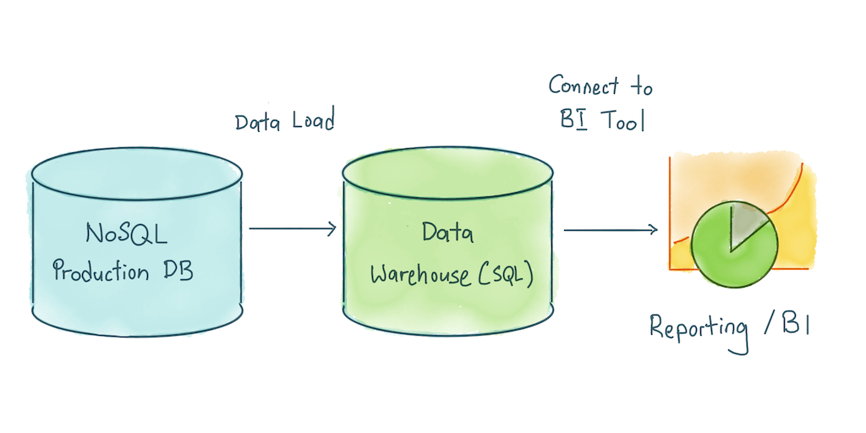
Why NoSQL Databases with Data Warehousing?
Scalability: Horizontally scalable to handle massive datasets.
Flexibility: Schema-less structure to adapt to dynamic data.
Performance: Optimized for read-heavy analytical workloads.
Cost-Effectiveness: Open-source options and pay-as-you-go cloud services.

Slide 7
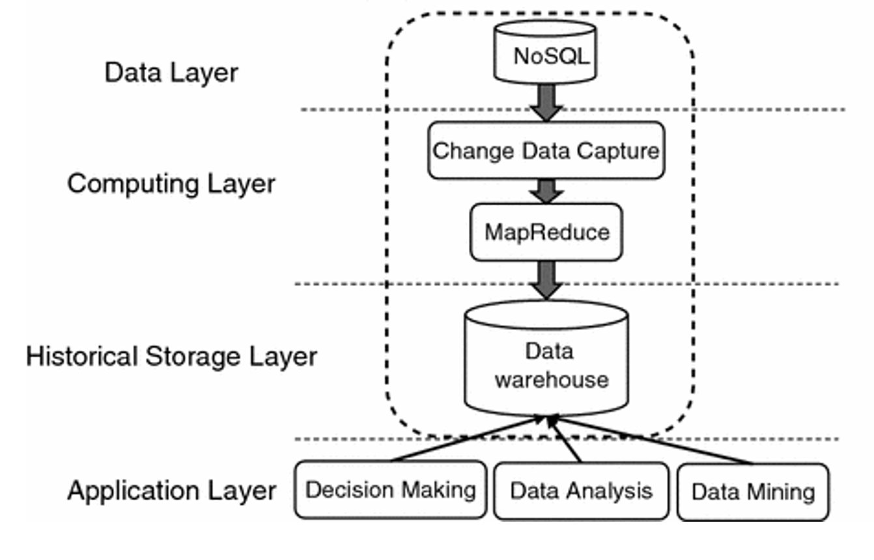

Slide 8

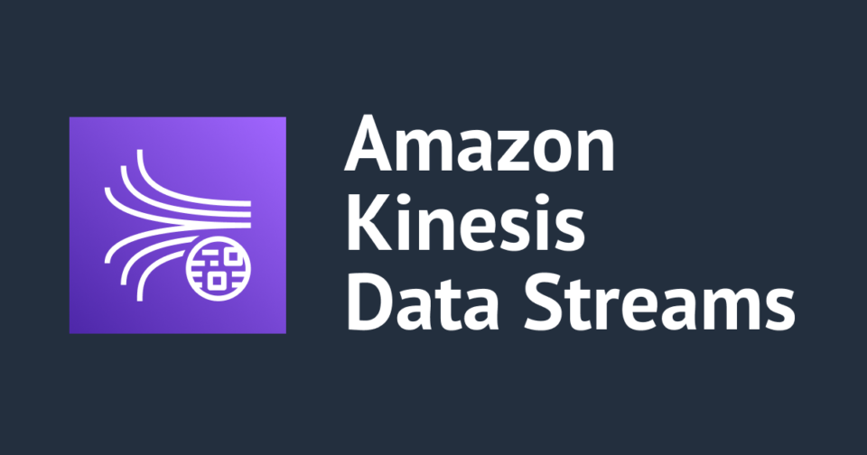

How NoSQL fits as a Data Warehouse ?
Analytical capabilities through integration with tools (e.g., Spark, Presto, Hive).
Visualization and reporting tools connected directly to NoSQL.

Slide 9
Use Cases and Challenges
Applications:
E-commerce: Personalization and recommendation engines.
IoT: Storing and analyzing real-time sensor data.
Social Media: User interaction analytics.
Challenges:
Querying: Limited SQL-like querying in some NoSQL systems.
Data Consistency: Eventual consistency may not suit all use cases.
Expertise: Learning curve for designing and optimizing NoSQL for analytics.

Slide 10
Real-Time Customer Personalization in E-Commerce
Use Case-1
Scenario:
An e-commerce platform needs to analyze vast amounts of customer behavior data, including clicks, purchases, and product views, to provide real-time personalized recommendations. The system must scale dynamically during peak shopping seasons (e.g., Black Friday) without performance bottlenecks.
Solution:
A NoSQL database like MongoDB or Cassandra serves as the central data store for user activity logs. The data warehouse is integrated with real-time analytics tools (e.g., Spark Streaming) to process data instantly and generate personalized recommendations displayed to users during their browsing session.
Benefits:
1- High scalability: Can handle millions of simultaneous users.
2- Low latency: Enables real-time insights for improved customer experience.

Slide 11
Use Case-2
IoT Analytics for Smart Cities
Scenario:
A smart city initiative collects data from thousands of IoT sensors deployed across traffic signals, parking meters, and environmental monitoring devices. This data must be aggregated and analyzed to optimize traffic flow, reduce pollution, and improve city operations.
Solution:
A NoSQL database like Amazon DynamoDB or Couchbase is used as a data warehouse to store and process sensor data. This system integrates with machine learning models to predict traffic patterns and suggest real-time adjustments to traffic signals, reducing congestion.
Benefits:
1- Scalable ingestion: Handles massive amounts of time-series data from IoT devices.
2- Flexible schema: Adapts to diverse sensor data formats without requiring schema redesign.

Slide 12
Data Warehouse Governance
and Backup Strategies
Effective governance and robust backup strategies are critical for managing user access and ensuring data warehouse reliability.
Role-Based Access Control (RBAC):
Grant users access based on their role (e.g., analyst, admin).
Minimize over-permissions.
Data Classification:
Define access levels for sensitive vs non-sensitive data.
Auditing and Monitoring:
Track user activities to ensure compliance and detect anomalies.
Compliance:
Align with regulations like GDPR, HIPAA, etc.

Slide 13
Data Warehouse Backup – Hardware and Software Backup
Hardware Backup:
Deploy redundant servers and storage devices across data centers.
Software Backup:
Periodic full and incremental backups using specialized tools.
Store backups in multiple locations (on-premises and cloud).
Disaster Recovery Plan:
Test backup restoration regularly.
Maintain a detailed recovery time objective (RTO) and recovery point objective (RPO).

Slide 14
Data Cleaning in Data Warehouses
Why Data Cleaning?
Remove inconsistencies, duplicates, and errors.
Improve data quality for reliable analytics.
Key Cleaning Processes:
Deduplication: Eliminating redundant records.
Handling Missing Data: Imputation or removal of incomplete records.
Standardization: Consistent formatting (e.g., dates, addresses).
Validation: Ensuring data adheres to defined rules.

Slide 15
Data Transformation in Data Warehouses
Purpose of Data Transformation:
Convert raw data into a structured format optimized for analysis.
Align data with the data warehouse schema (star or snowflake models).
Common Transformation Techniques:
Aggregation: Summarizing data (e.g., total sales per region).
Data Enrichment: Adding external data to enhance context.
Data Splitting/Merging: Adjusting granularity for analytics.
Encoding: Converting data into standard formats (e.g., categorical to numerical).

Slide 16

End of the Lecture # 3
Qustions ?? (5mins)
Open disscuation .. (3mins)

